Slide 1
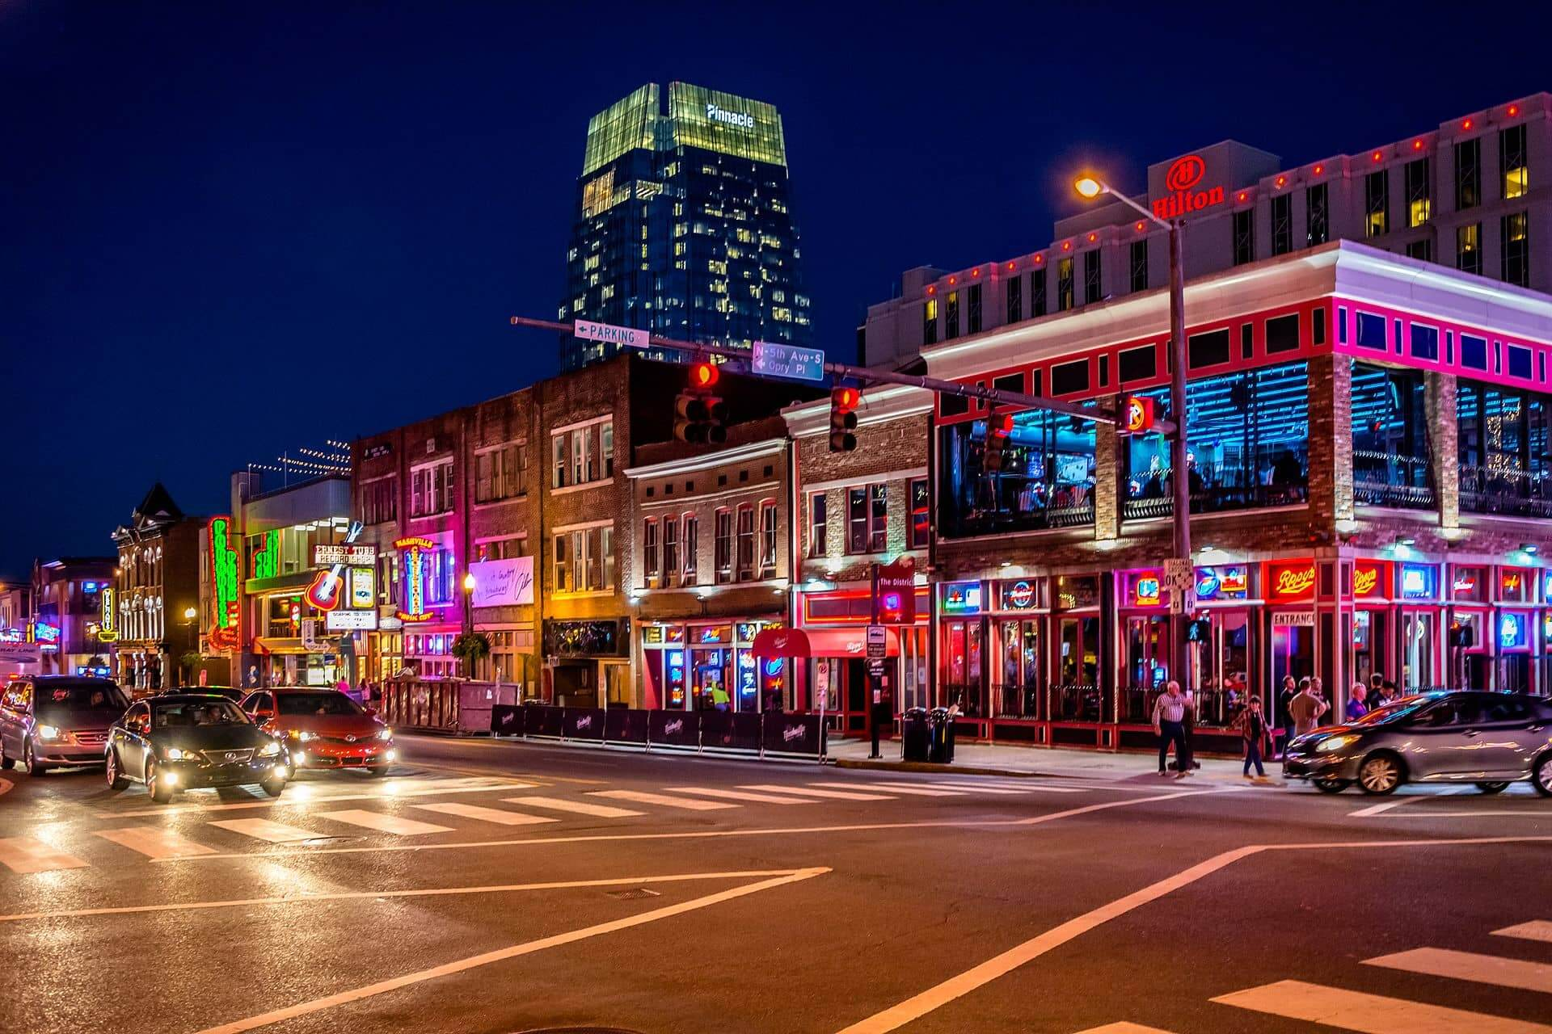
National TSA Conference
June 27th-July 1st |Nashville, TN

Slide 2
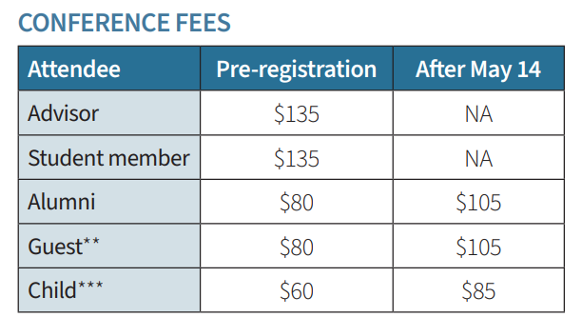
Registration Opens March 1st
Registration includes:
Conference t-shirt
Conference pin
TSA lanyard
Drawstring Bag
https://tsaweb.org/docs/default-source/national-conferences/2025/2025-registration-information.pdf?sfvrsn=120696a9_4

Slide 3
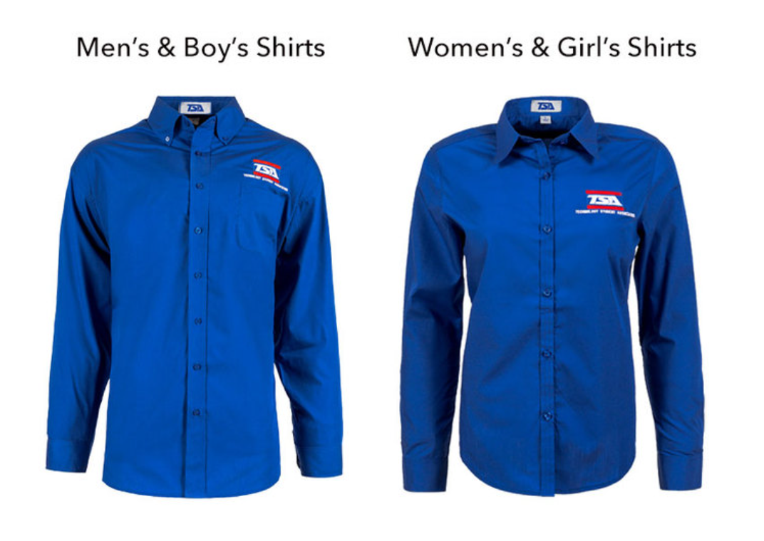
Dress Code
Official royal blue TSA shirt.
Gray pants, or knee-length Skirt
Black dress shoes worn with back or dark blue socks.
All dress code requirements may be found on the TSA website.

Slide 4
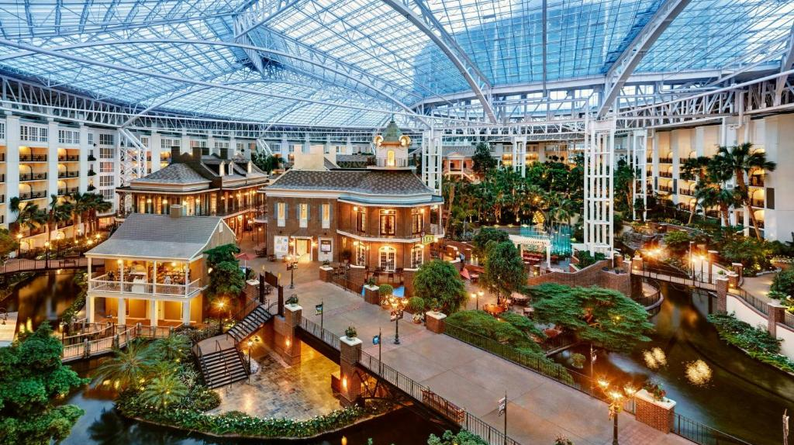
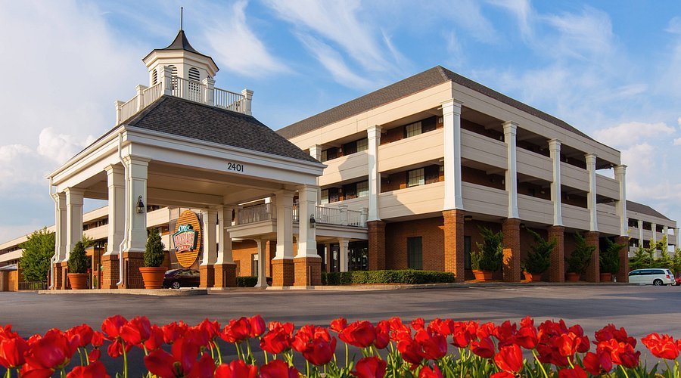
Hotels
Gaylord Opryland
Inn at Opryland
$222 per night
$209 per night

Slide 5
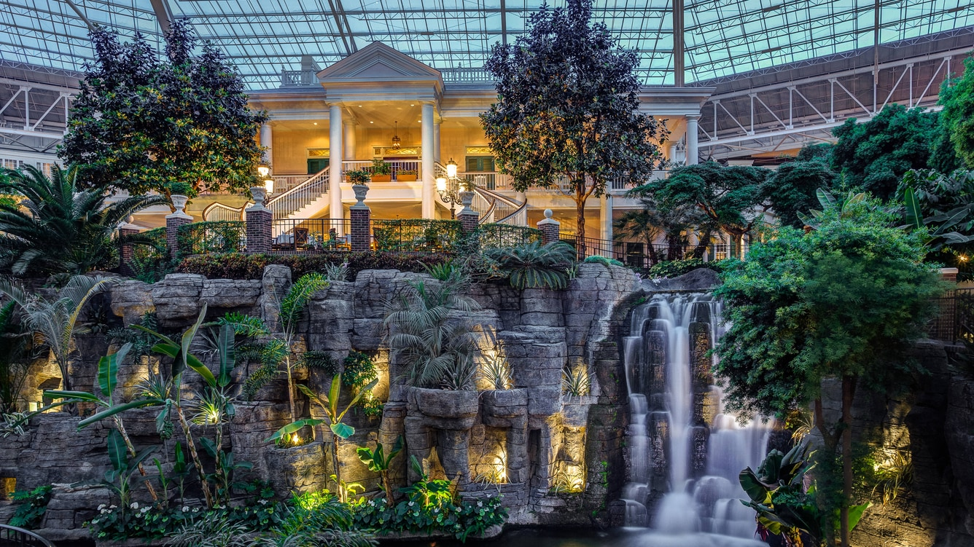
Lunch and Dinner Ideas
Gaylord Opryland Resort
Cocoa Bean
Conservatory Cafe
Delta Marketplace
The Falls Bar & Lounge
Solario Cantina
Jack Daniel’s
Fuse Sports Bar
Cascades American Café
Ravello
Old Hickory Steakhouse

Slide 6
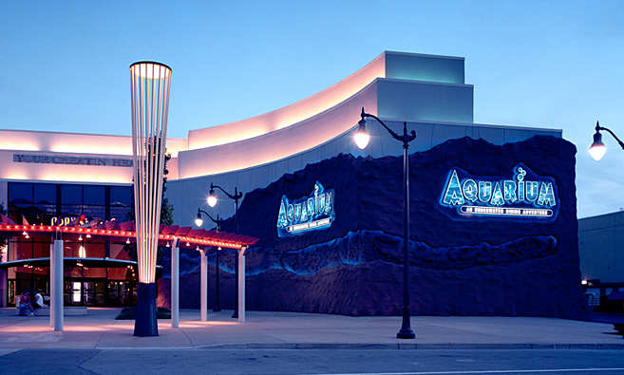
Lunch and Dinner Ideas
Dave and Busters- Nashville
Aquarium Restaurants
Rainforest Café
Johnny Rockets
Opry Mills

Slide 7
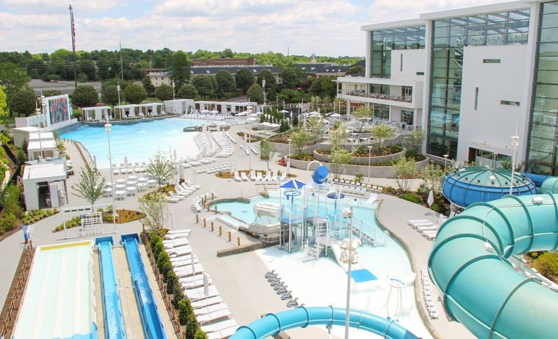
SoundWaves Water Experience
Discount tickets to Gaylord Opryland Waterpark are only available to guests of the Gaylord Opryland Resort and national TSA conference registered attendees.
Tickets | SoundWaves Water Experience | Gaylord Opryland Tickets

Slide 8
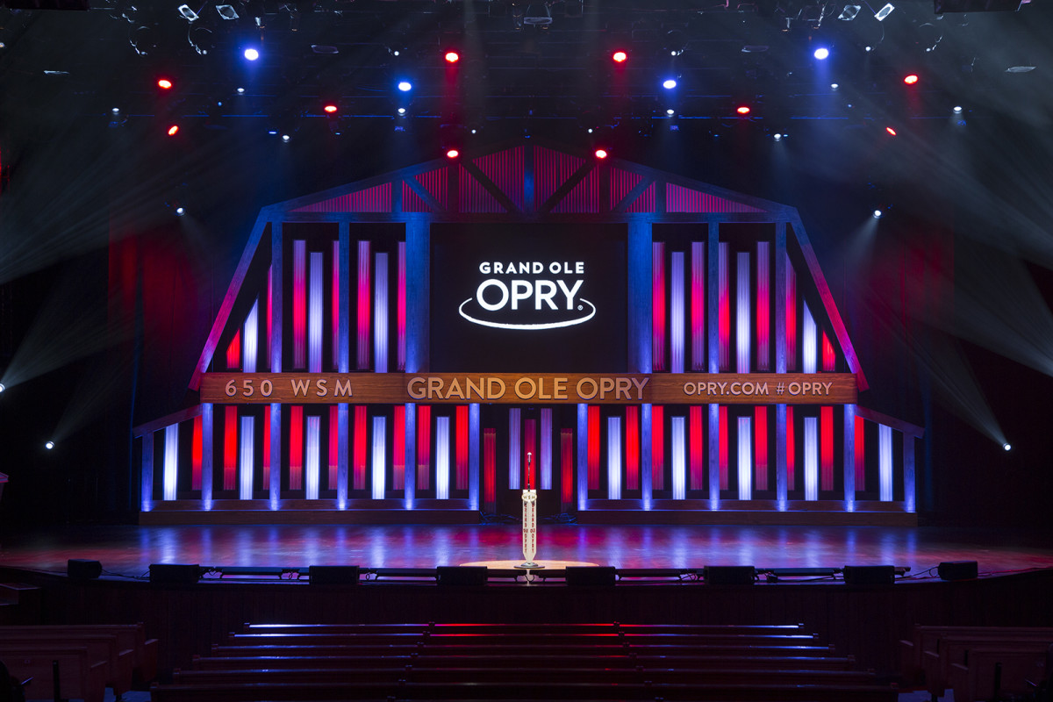
Grand Ole Opry
Country Music Concerts in Nashville Group Tickets (must be ordered 45 days in advance)

Slide 9
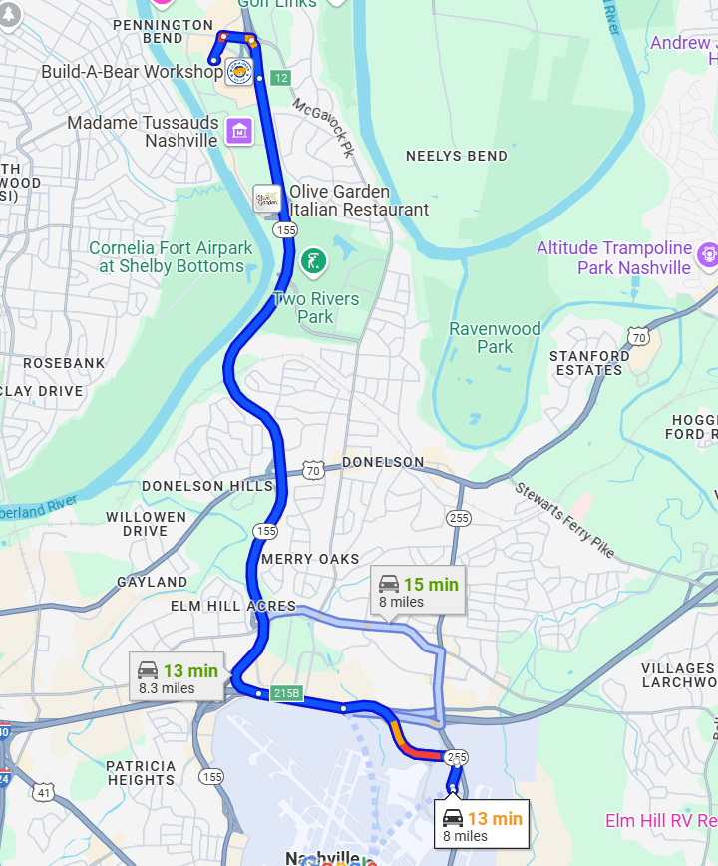
Travel from and to Airport
Uber or Lyft
$30.00 -$50.00/sedan, one way
Shuttles
$32 per person, round trip

Slide 10
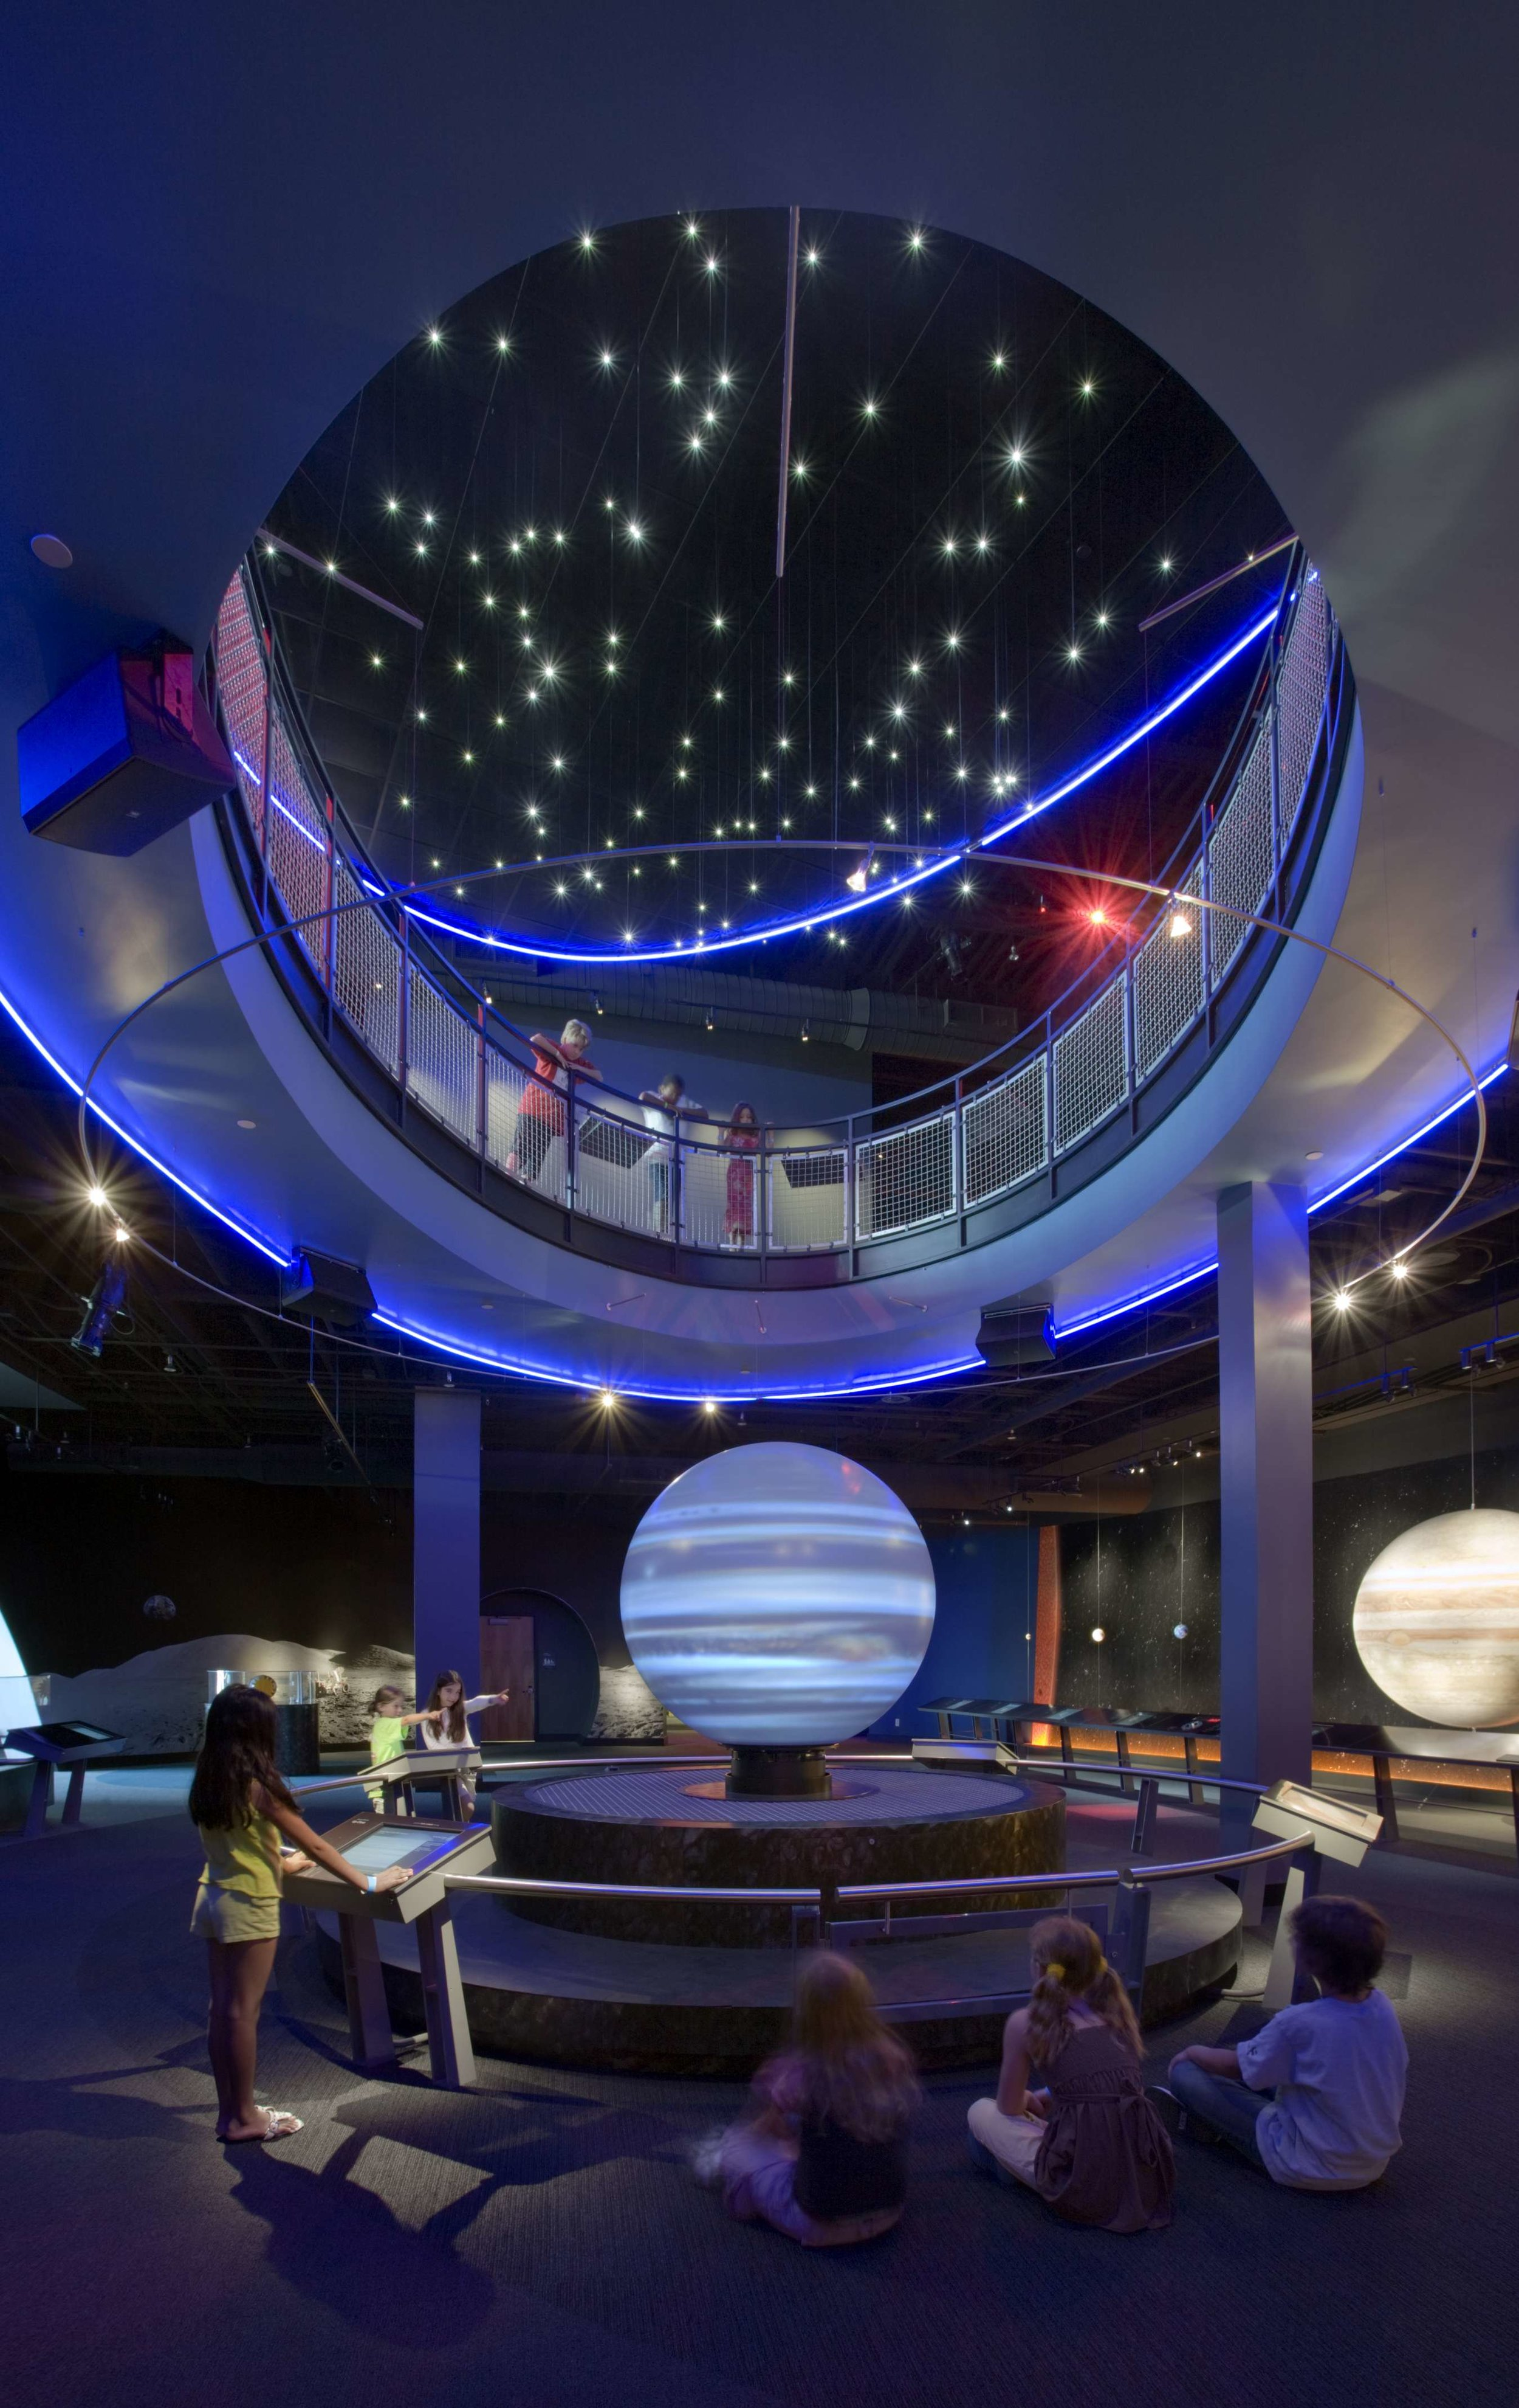
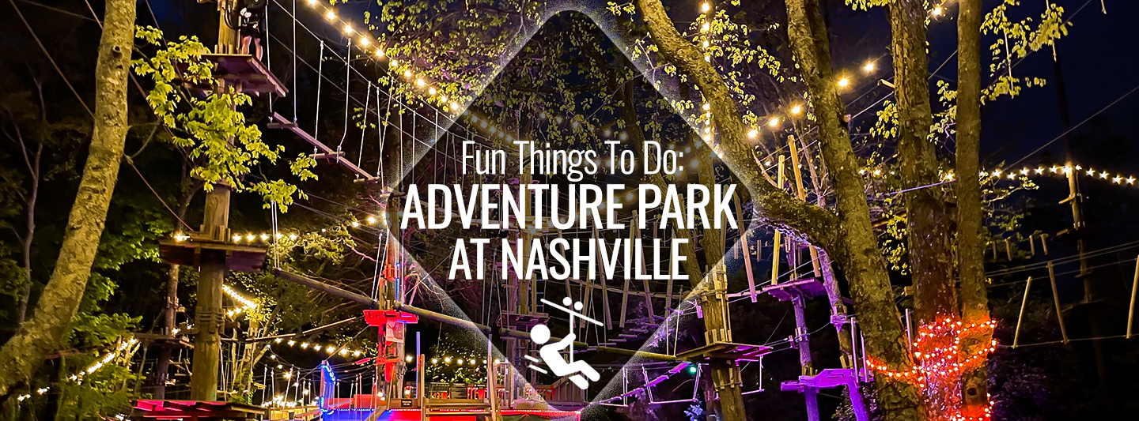
Things to do
Country Music Hall of Fame $29.95
Adventure Science Museum $22
Parthenon $10
Nashville Zoo at Grassmere $25
Lane Motor Museum $3-$15
The Adventure Park in Nashville $63

